Slide 1
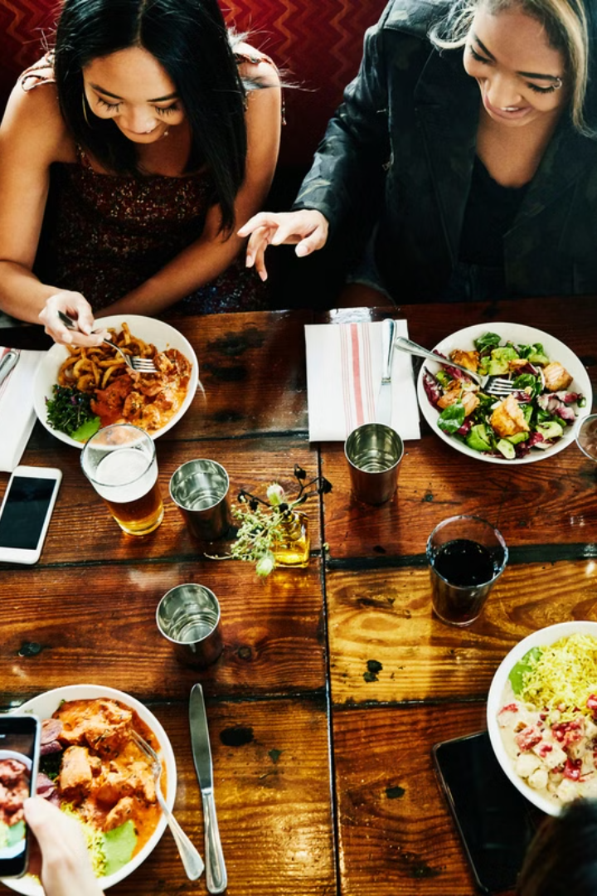
Food and Beverage Industry Survey Analysis
This presentation explores key insights from a recent survey of consumer preferences in the food and beverage industry. I utilize Power BI to analyze data and visualize key findings.
By Rishi P

Slide 2
Project Overview
Purpose
Objective
Methodology
To understand consumer behavior, preferences, and perceptions within the food and beverage industry.
To provide actionable insights and recommendations for businesses in the food and beverage industry.
Data cleaning, Power BI data modeling, data visualization, and dashboard creation.

Slide 3
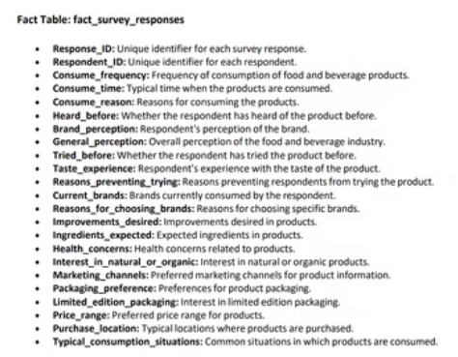
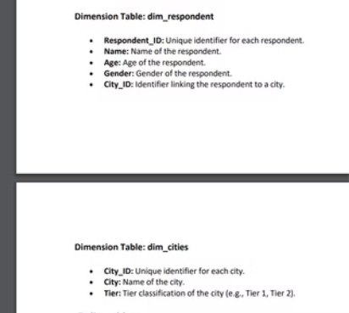
Data description
1
Data Source
2
Data Composition
3
Data Structure
Survey responses from a sample of consumers representing a diverse range of demographics and consumption habits.
Key variables include frequency of consumption, preferred food and beverage categories, brand perceptions, and health concerns.
A fact table containing survey responses and two dimension table with demographic and city related attributes.

Slide 4
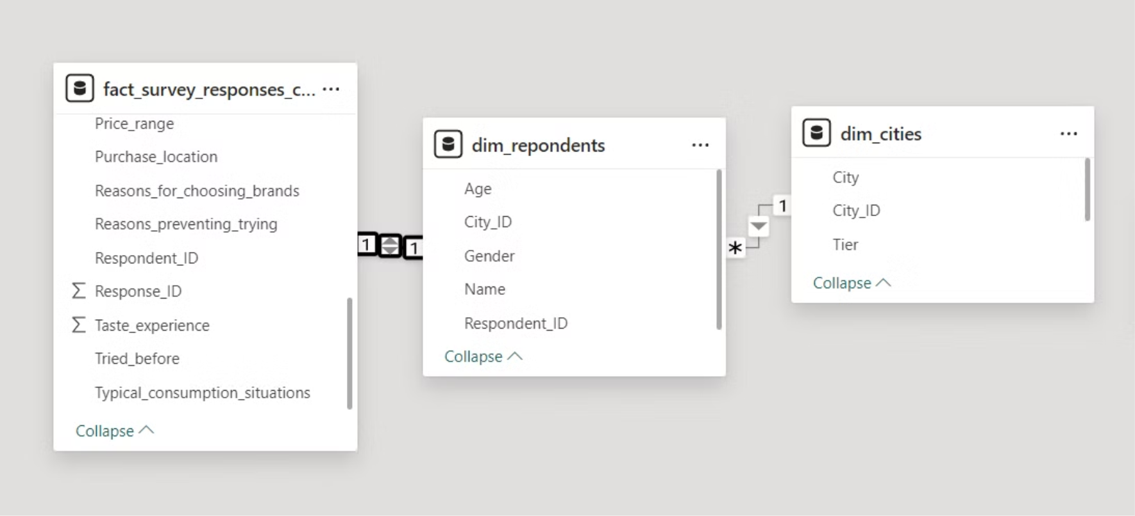
Data Cleaning
Standardized Column Values: Corrected inconsistent names and values for better visualization.
Spelling Corrections: Fixed spelling errors to ensure data accuracy.
Handled Missing Data: Checked for null values and addressed them appropriately.
Error Correction: Identified and corrected data errors using Power Query.
Data Modeling

Slide 5
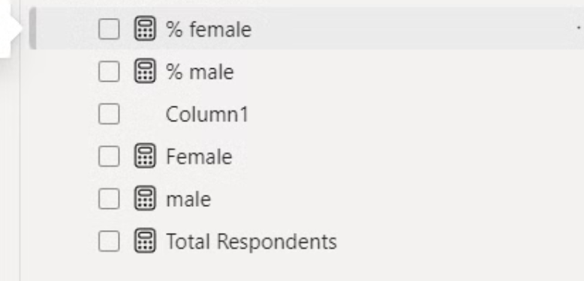
New measures
Total Respondents = COUNTROWS(fact_survey_responses_cleaned)
male = CALCULATE(COUNTROWS(fact_survey_responses_cleaned),dim_repondents[Gender]="Male")
Female = CALCULATE(COUNTROWS(fact_survey_responses_cleaned),dim_repondents[Gender]="Female")
% male = DIVIDE([male],[Total Respondents],0)
% female = DIVIDE([Female],[Total Respondents],0)

Slide 6
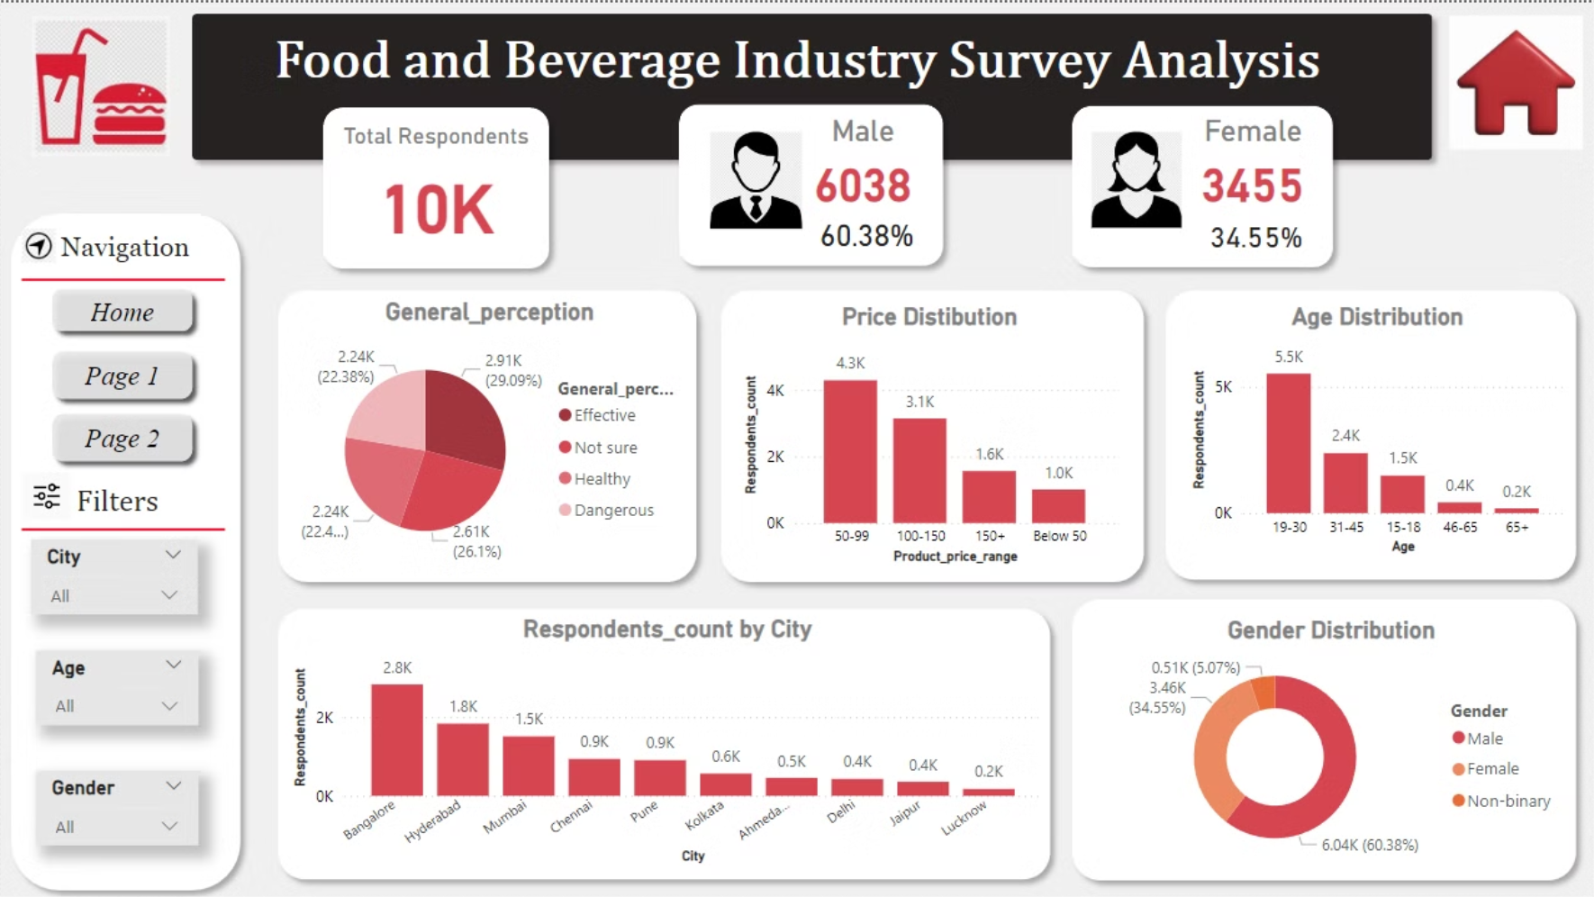
Dashboard
Home

Slide 7
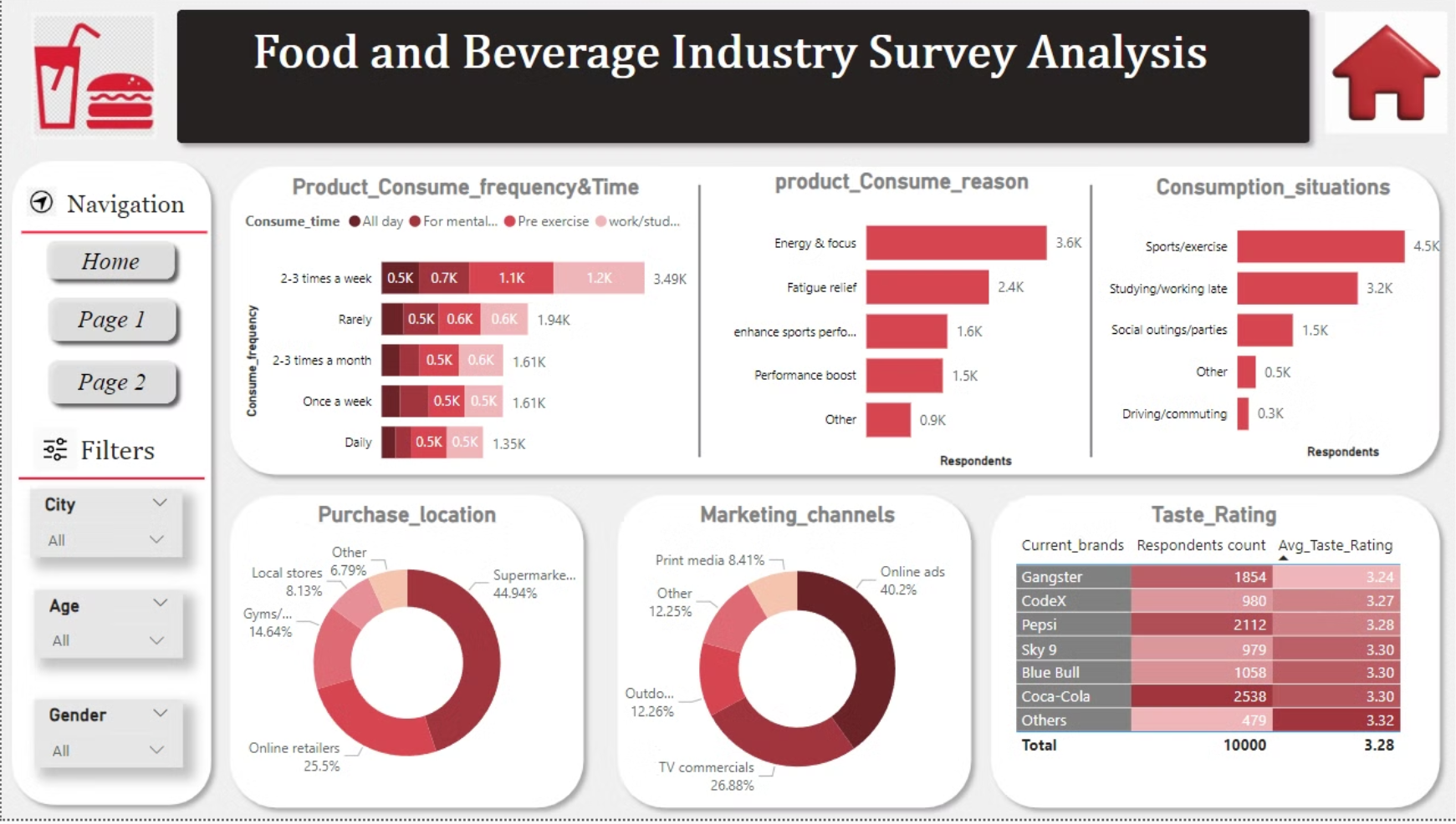
Page 1

Slide 8
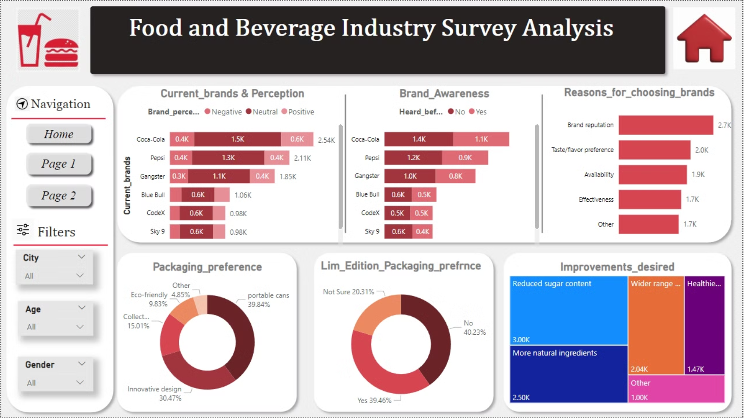
Page 2

Slide 9
Key Insights - Demographics and General Perception:
1
60.38% of respondents are male, and 34.55% are female.
2
Over 29% view the products as "effective," while 22% see them as "healthy." A combined 48.4% are either "not sure" or consider the products "dangerous."
3
More than 50% of respondents are aged between 19-30.

Slide 10
Key Insights - Consumption and Preferences:
The majority of respondents consume products 2-3 times a week, mainly for concentration during work/study and pre-exercise.
The most popular price range is 50-99, which is the lowest range.
Respondents primarily purchase products from supermarkets and prefer portable cans with innovative designs for packaging.

Slide 11




Key Insights - Brand and Marketing:
Coca-Cola is the most preferred brand, followed by Pepsi, while Codex and Sky 9 are the least preferred.
Brand reputation is the top reason for brand selection, followed by taste/flavor.
The most preferred marketing channel is online ads, while print media is the least preferred.
Health and Improvement:
There is a desire for reduced sugar content and more natural ingredients in products.
The average taste rating for products is around 3.32 to 3.34, indicating room for improvement in taste.

Slide 12
Areas for Improvement
Product Health Perception
With 48.4% of respondents unsure or viewing the products as dangerous, there’s a need to improve the health perception of the products. This could involve better communication of health benefits and transparency in ingredient sourcing.
Product Taste and Quality
Given the average taste rating of 3.32 to 3.34, enhancing the flavor profiles and quality of the products could improve customer satisfaction and brand loyalty.
Packaging preferences
There is a significant interest in portable cans and innovative designs. Enhancing packaging design could attract more consumers, especially in younger age groups.
Brand awareness
Since many respondents have not heard of the products before, increasing brand visibility through targeted marketing campaigns is crucial.

Slide 13




Recommendations
Focus on youger demographics
Improve Taste Profile
Embrace Digital Marketing
Engage with Consumers
Tailor marketing strategies and product development to appeal to the 19-30 age group, who form a significant portion of your consumer base.
Invest in R&D to develop and enhance flavor profiles, ensuring that products meet the evolving taste preferences of consumers.
Utilize digital marketing channels, social media, and targeted advertising to reach consumers effectively and build brand awareness.
Actively engage with consumers through feedback mechanisms, social media interactions, and customer service to understand their needs and preferences.

